Slide 1
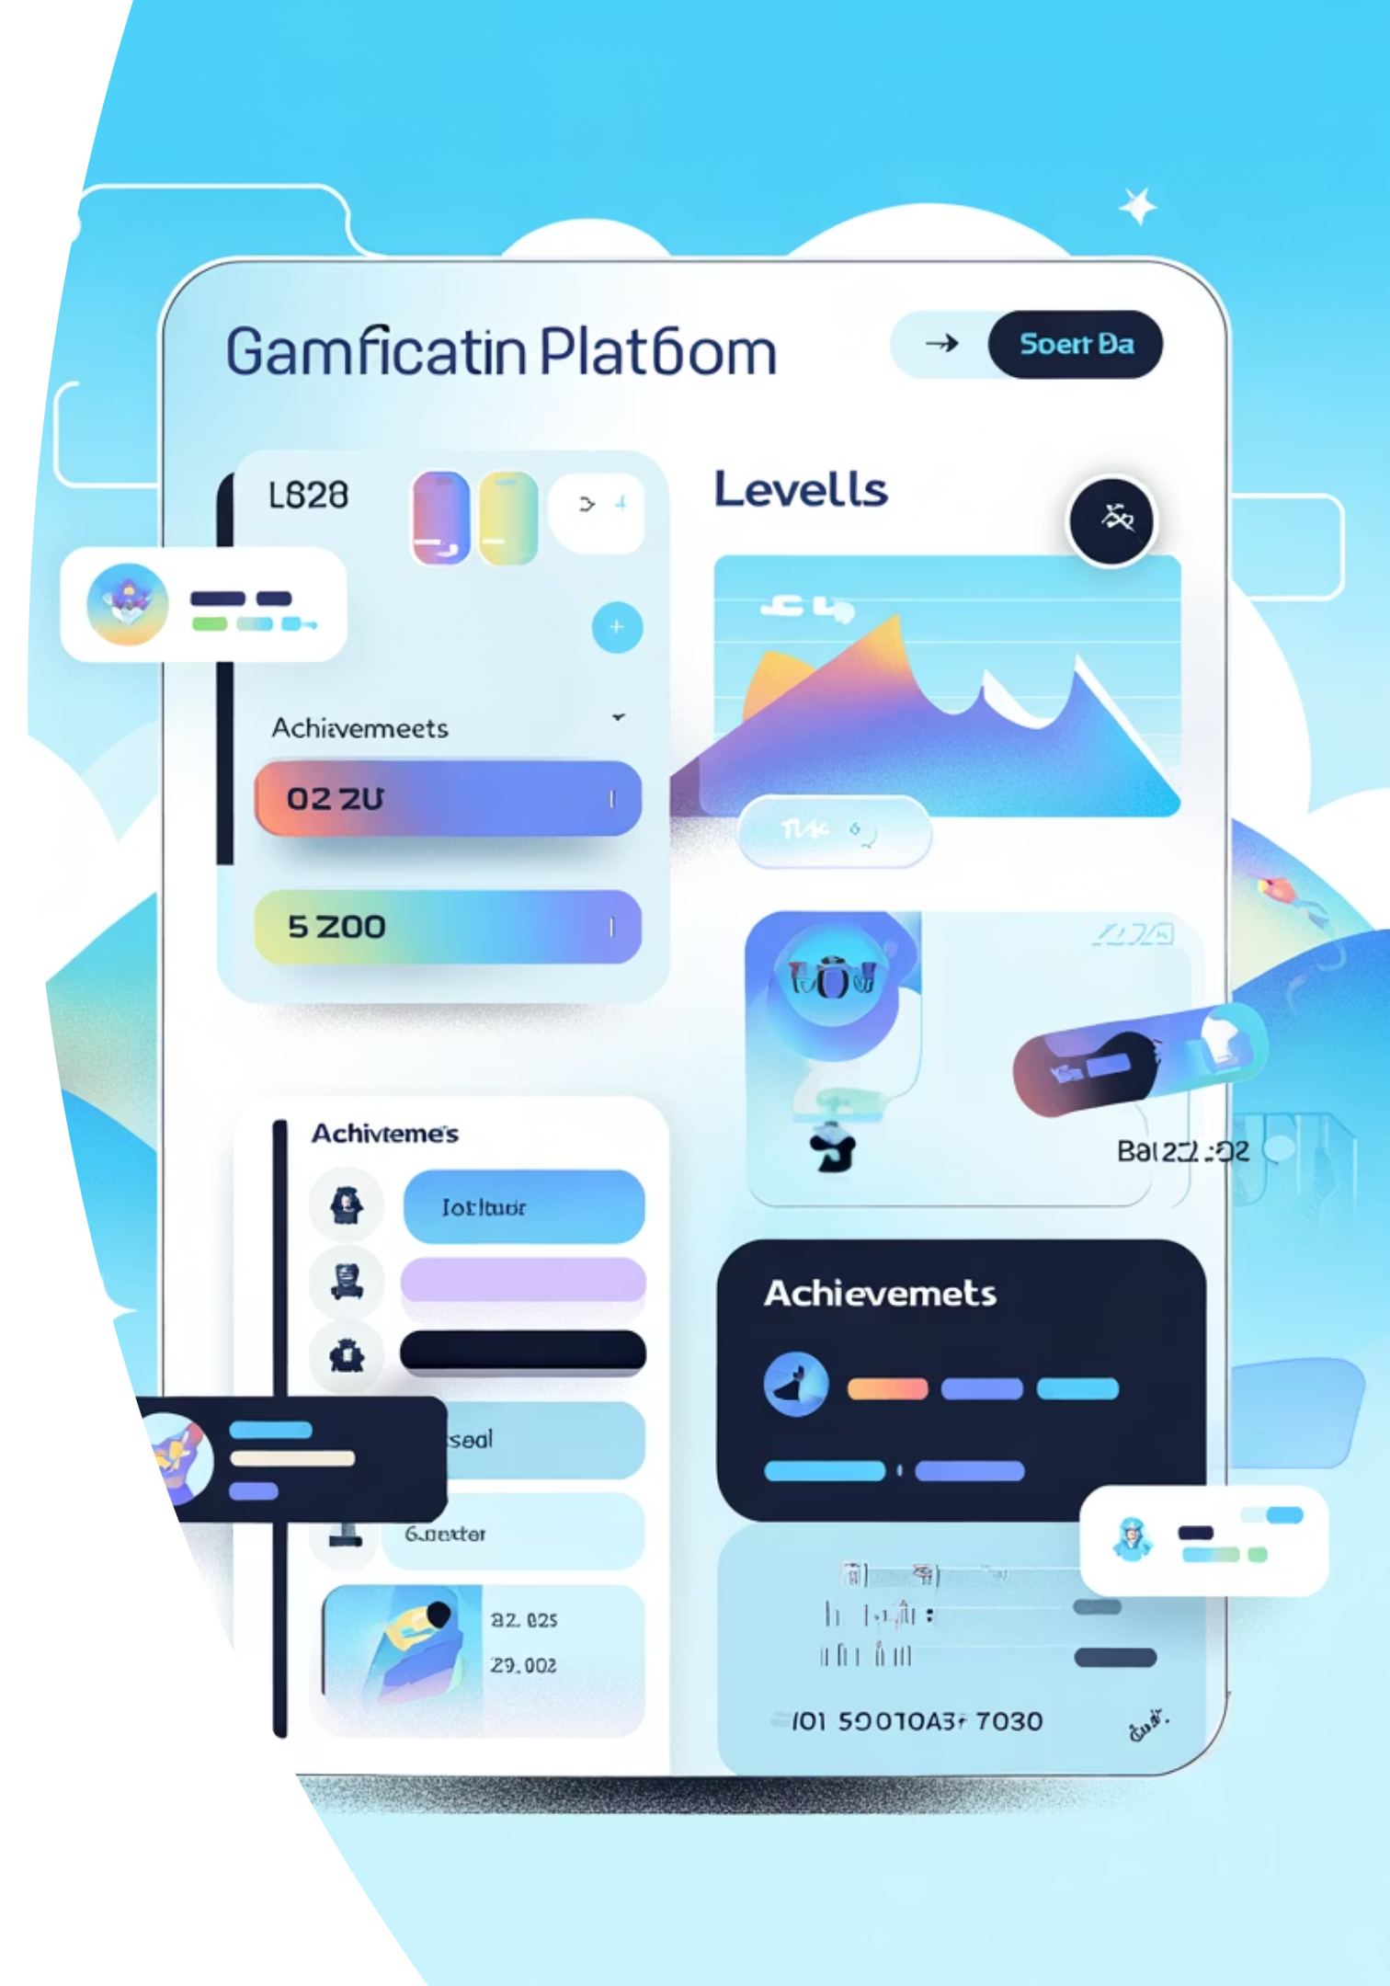
LevelUp: Gamified Community Platform
Transforming community engagement through AI-powered quests and progressive leveling systems

Slide 2

What is LevelUp?
Core Concept
Key Features
Multi-community platform where users complete AI-generated daily quests to level up individually and boost their community's collective XP
Join multiple communities simultaneously
AI-generated daily quest system
Individual & community progression tracking
Gamified engagement mechanics

Slide 3








Technology Stack
Database Layer
Backend
PostgreSQL hosted on Neon with Prisma ORM for type-safe queries
Node.js + Express.js in TypeScript, deployed on Render
Frontend
Mobile
Next.js web application deployed on Vercel
React Native for cross-platform mobile experience

Slide 4
Database Architecture
User Management
Community System
Quest Framework
Authentication & authorization
Community creation & customization
AI-generated quests
Role-based access control
Completion tracking
User profiles & analytics
Membership tracking
Level progression system
XP aggregation logic

Slide 5
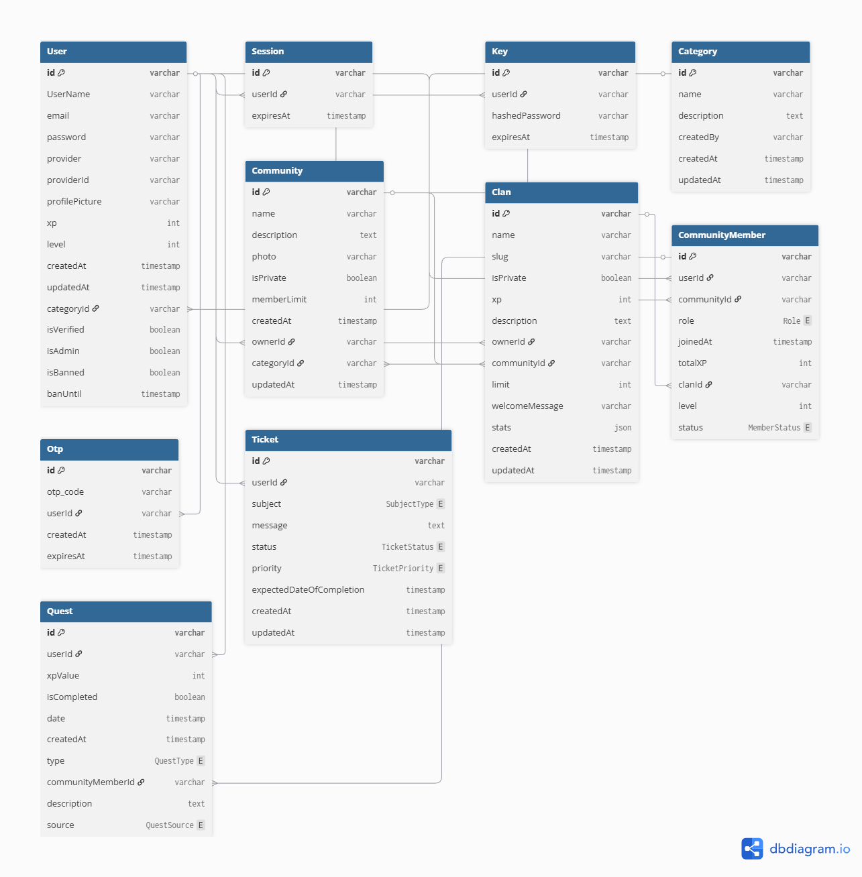

Slide 6
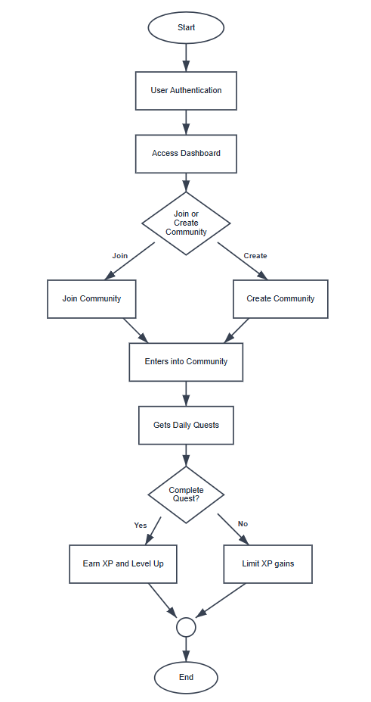
Flowchart Part 1

Slide 7
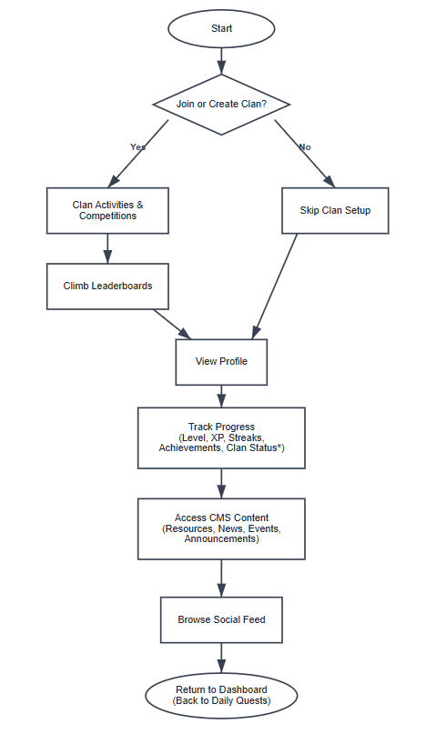
Flowchart Part 1
(Inside Community)

Slide 8



Completed Features
1
Secure Authentication System
JWT based authentication system.
Secure password hashing - bcrypt
2
Role Based Access Control
Different user roles ( admin, user , appropriate access level throughout the application
3
Admin Dashboard
User analytics with ineractive user growing charts and user insights
4
User Management
Complete CRUD operations for user accounts with pagination for handling large dataset
5
Community Features
Community creation , Join and customize the community by pin

Slide 9




Technical Challenges
The Problem
Loading all records at once made the UI slow and difficult to navigate.
Our Solution
Implemented pagination to load a limited number of users per page (e.g., 10, 25, or 50).
Outcome
The table now loads faster and handles large datasets efficiently.

Slide 10

Technical Challenges
The Problem - SMTP Limitations on Vercel
Vercel's platform updates deprecated SMTP functionality, breaking our email reset system
Our Solution
Migrated to third-party email platform(Resend) for reliable password reset and transactional emails
Lessons Learned
Cloud platform restrictions can emerge unexpectedly

Slide 11



Technical Challenges
The Problem - Image Storage
Loading images globally was slower because there was no CDN.
Saving images locally increased server storage usage as the number of images grew.
Our Solution
Integrated Cloudinary for image storage.
Uploaded images to Cloudinary instead of saving them locally.
Outcome
Server storage is no longer overloaded.
Images load faster globally.

Slide 12
TO DO:
Notifications
1
Real-time notification system for quest updates, community activity, and level achievements
2
Mobile App
Complete React Native mobile experience with push notifications and offline support
AI Integration
3
Advanced AI quest generation with personalized difficulty and smart recommendations
4
CMS
Social media features to make users more interactive

Slide 13

Team Contributions
3
100%
Team Members
Coverage
Full-stack collaboration
Frontend, backend, database
Collaborative Excellence
Each team member contributed effectively across the full stack, ensuring seamless integration between frontend, backend, and database layers

Slide 14
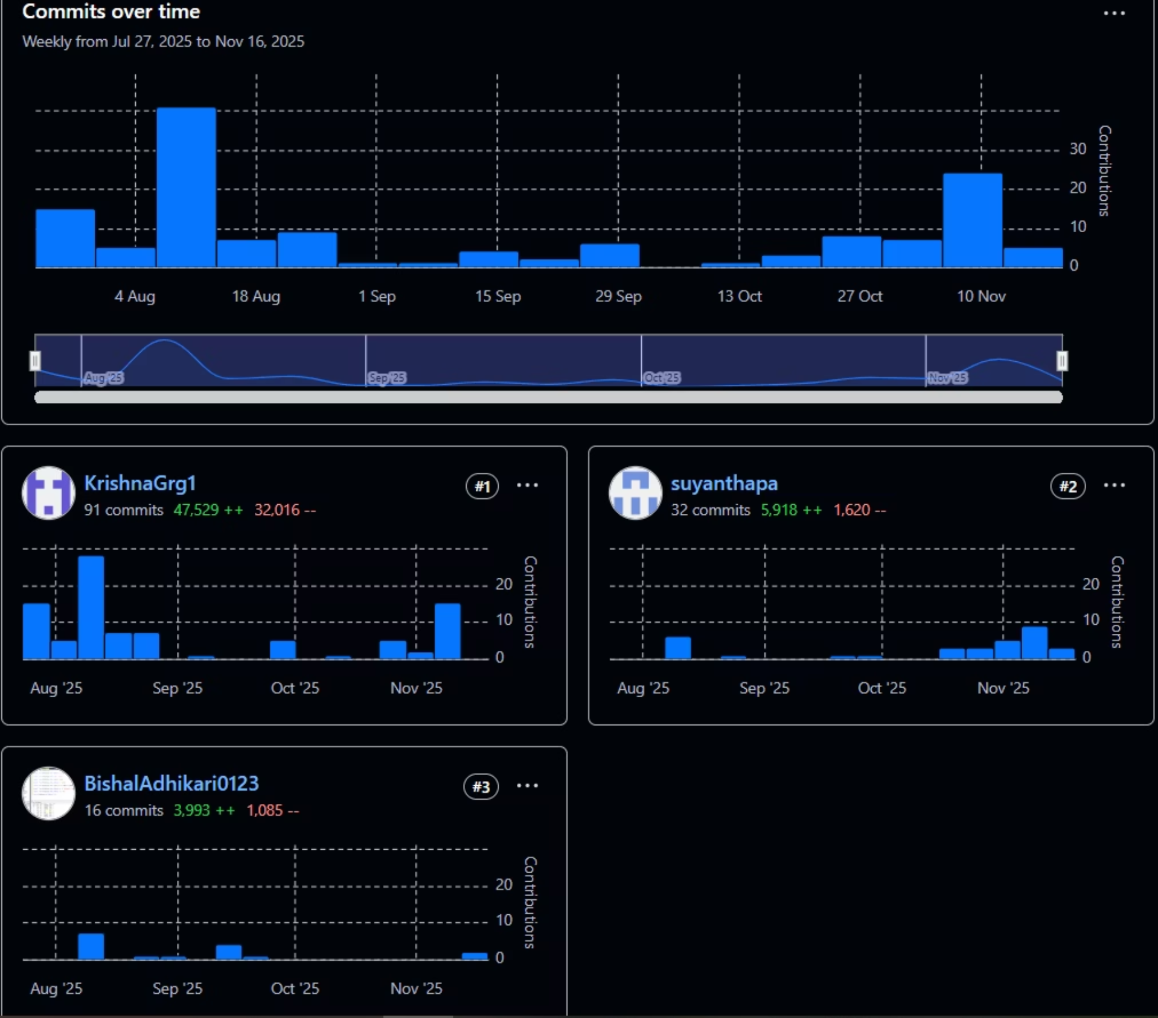
Frontend Contribution

Slide 15
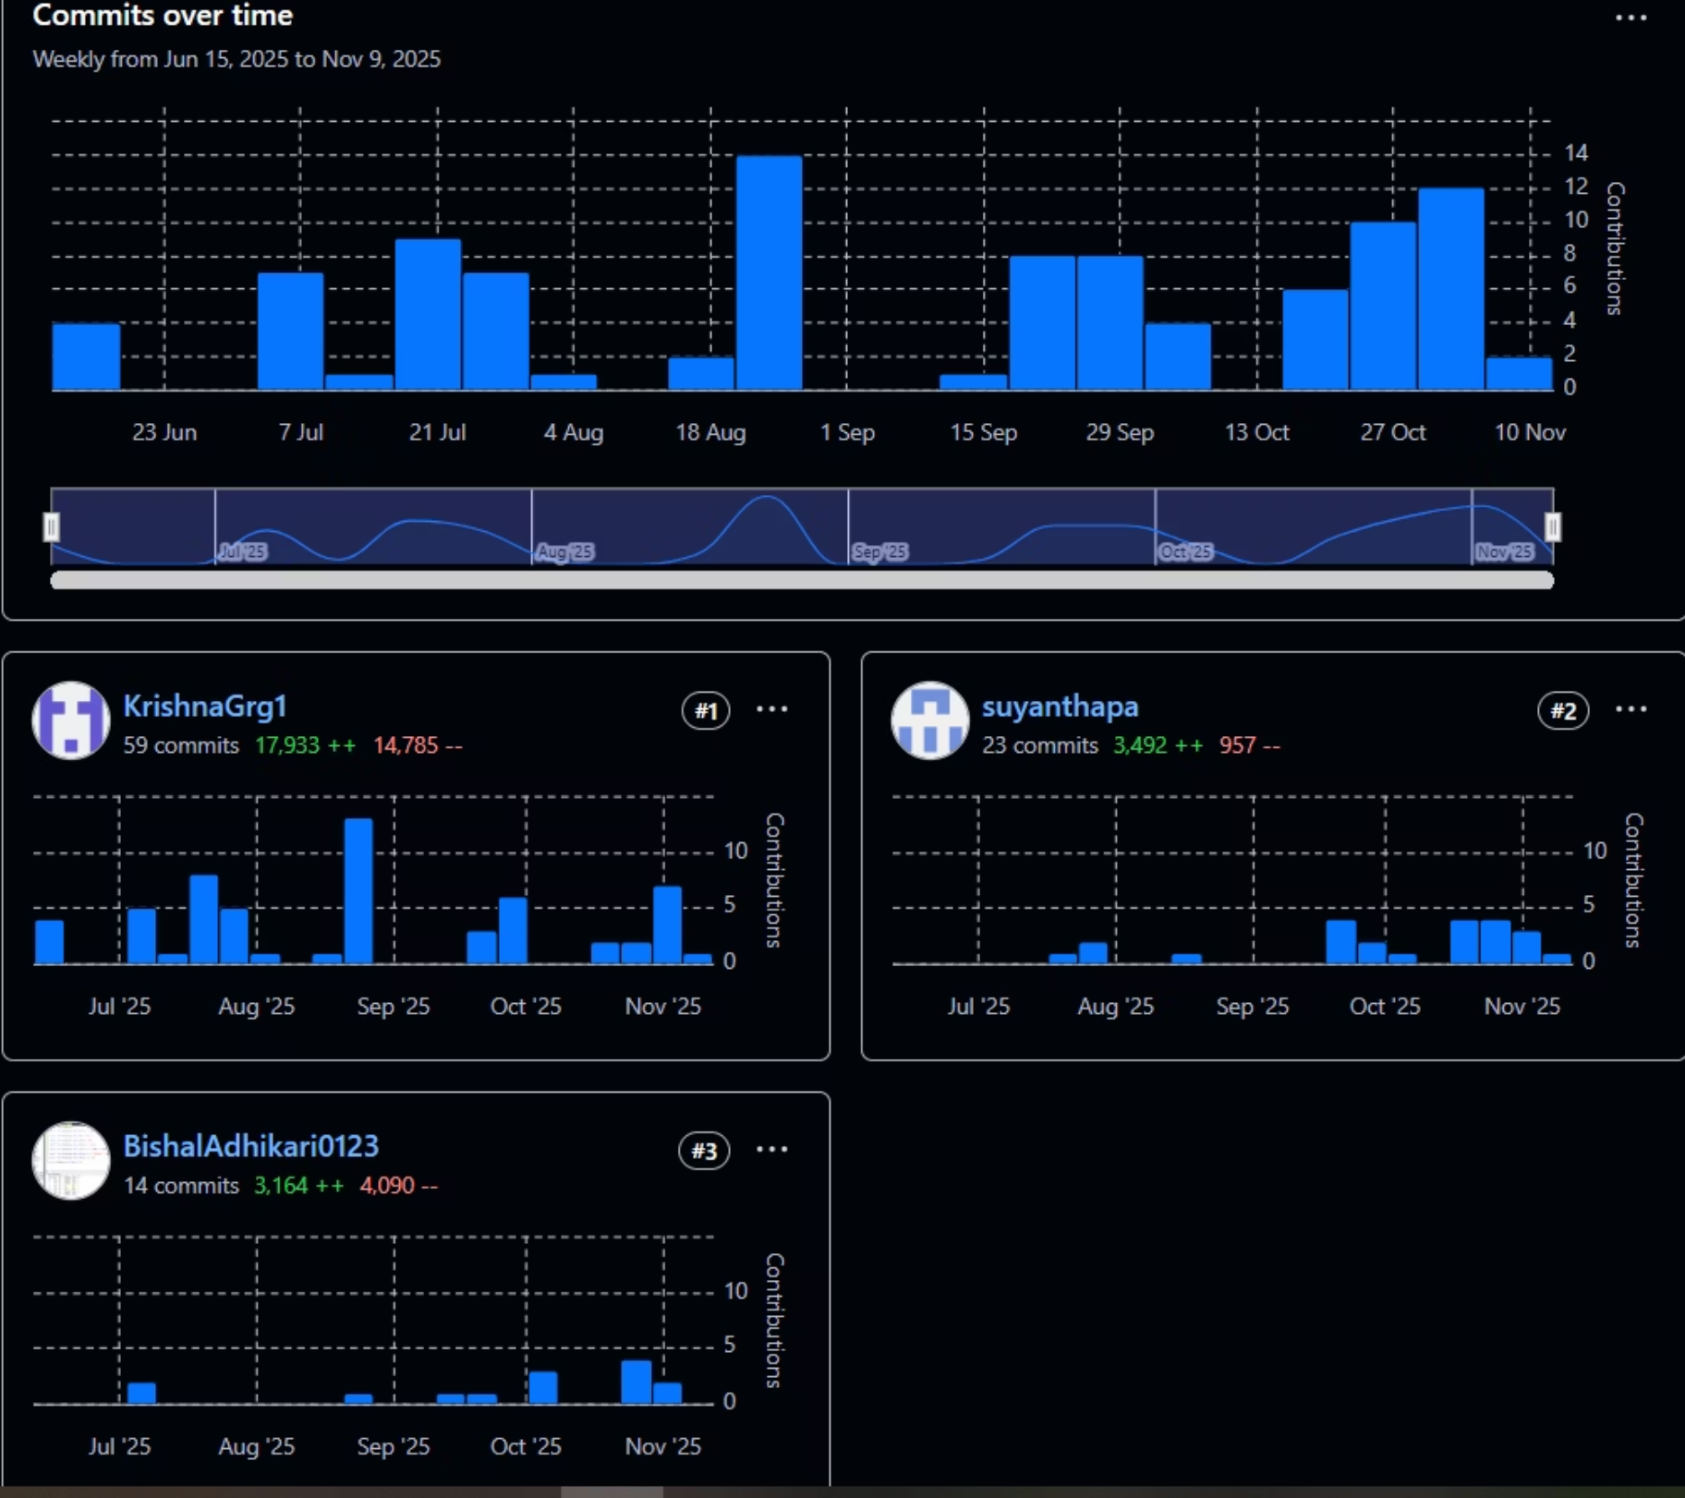
Backend Contribution

